Slide 1
SDLC
Software development life cycle

Slide 2
SDLC
SDLC is a process that consists of a series of planned activities to develop or alter the Software Products.

Slide 3
Planning
Defining
Designing
Building
Testing
Deployment

Slide 4
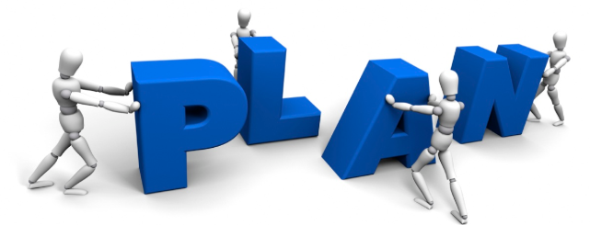
Stage 1: Planning and Requirement Analysis
It is performed by the senior members of the team with inputs from the customer, the sales department, market surveys and domain experts in the industry. This information is then used to plan the basic project approach and to conduct product feasibility study in the economical, operational and technical areas.
The outcome of the technical feasibility study is to define the various technical approaches that can be followed to implement the project successfully with minimum risks.

Slide 5

Stage 2: Defining Requirements
This is done through an SRS (Software Requirement Specification) document which consists of all the product requirements to be designed and developed during the project life cycle.

Slide 6
Stage 3: Designing the Product Architecture
Based on the requirements specified in SRS, usually more than one design approach for the product architecture is proposed and documented in a DDS - Design Document Specification.
This DDS is reviewed by all the important stakeholders and based on various parameters as risk assessment, product robustness, design modularity, budget and time constraints, the best design approach is selected for the product

Slide 7
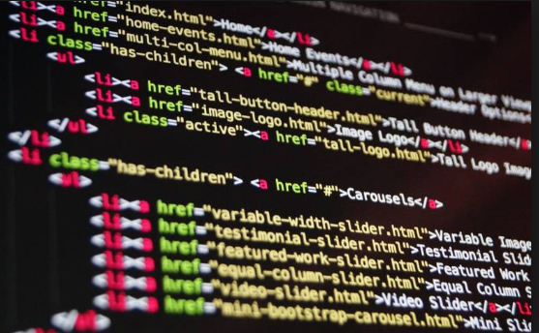
Stage 4: Building or Developing the Product
The programming code is generated as per DDS during this stage. If the design is performed in a detailed and organized manner, code generation can be accomplished without much hassle.

Slide 8
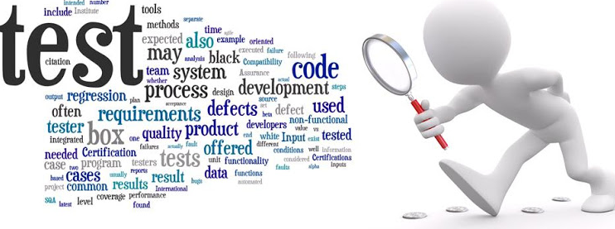
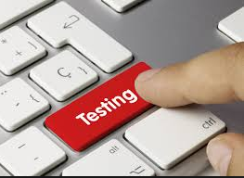
Stage 5: Testing the Product
This stage is usually a subset of all the stages as in the modern SDLC models, the testing activities are mostly involved in all the stages of SDLC.
However, this stage refers to the testing only stage of the product where product defects are reported, tracked, fixed and retested, until the product reaches the quality standards defined in the SRS.

Slide 9
Stage 6: Deployment in the Market and Maintenance
Released formally in the appropriate market.
After the product is released in the market, its maintenance is done for the existing customer base.

Slide 10
SDLC Models
Waterfall Model
Iterative Model
Spiral Model
V-Model
Big Bang Model
Agile Model
Other related methodologies are RAD Model, Rapid Application Development and Prototyping Models.

Slide 11
SDLC - Waterfall Model
First Process Model Introduced.
linear-sequential life cycle model.
Simple to understand and use.
Each phase must be completed before the next phase can begin.
No overlapping in the phases.

Slide 12
Waterfall Model - Design
In this Waterfall model, typically, the outcome of one phase acts as the input for the next phase sequentially.

Slide 13
Requirement Analyses
Implementation
Testing
Deployment
Maintenance
System Design

Slide 14
Waterfall Model
Requirement Gathering and analysis − All possible requirements of the system to be developed are captured in this phase and documented in a requirement specification document.
System Design − The requirement specifications from first phase are studied in this phase and the system design is prepared. This system design helps in specifying hardware and system requirements and helps in defining the overall system architecture.
Implementation − With inputs from the system design, the system is first developed in small programs called units, which are integrated in the next phase. Each unit is developed and tested for its functionality, which is referred to as Unit Testing.

Slide 15
Waterfall Model Continue
Integration and Testing − All the units developed in the implementation phase are integrated into a system after testing of each unit. Post integration the entire system is tested for any faults and failures.
Deployment of system − Once the functional and non-functional testing is done; the product is deployed in the customer environment or released into the market.
Maintenance − There are some issues which come up in the client environment. To fix those issues, patches are released. Also to enhance the product some better versions are released. Maintenance is done to deliver these changes in the customer environment.

Slide 16
Waterfall Model - Application
Requirements are well documented, clear and fixed.
Technology is understood and is not dynamic.
No ambiguous requirements.
The project is short.

Slide 17
Waterfall Model - Disadvantages
The disadvantage of waterfall development is that it does not allow much reflection or revision. Once an application is in the testing stage, it is very difficult to go back and change something that was not well-documented or thought upon in the concept stage.
No working software is produced until late during the life cycle.
High amounts of risk and uncertainty.
Poor model for long and ongoing projects.

Slide 18
Not suitable for the projects where requirements are at a moderate to high risk of changing. So, risk and uncertainty is high with this process model.
Cannot accommodate changing requirements.

Slide 19
SDLC - Iterative Model

Slide 20
In the Iterative model, iterative process starts with a simple implementation of a small set of the software requirements and iteratively enhances the evolving versions until the complete system is implemented and ready to be deployed.
An iterative life cycle model does not attempt to start with a full specification of requirements. Instead, development begins by specifying and implementing just part of the software, which is then reviewed to identify further requirements. This process is then repeated, producing a new version of the software at the end of each iteration of the model.

Slide 21
Iterative Model - Design
Iterative process starts with a simple implementation of a subset of the software requirements and iteratively enhances the evolving versions until the full system is implemented.

Slide 22
Design & Development
Design & Development
Testing
Implementation
Testing
Implementation
Requirements
Testing
Implementation
Design & Development
Build 1
Build 2
Build 3

Slide 23
"During software development, more than one iteration of the software development cycle may be in progress at the same time." This process may be described as an "evolutionary acquisition" or "incremental build" approach.“
the whole requirement is divided into various builds.
During each iteration, the development module goes through the requirements, design, implementation and testing phases

Slide 24
Iterative Model - Application
Requirements of the complete system are clearly defined and understood.
Major requirements must be defined; however, some functionalities or requested enhancements may evolve with time.
There is a time to the market constraint.
A new technology is being used and is being learnt by the development team while working on the project.

Slide 25
Iterative Model - Advantages
Some working functionality can be developed quickly and early in the life cycle.
Results are obtained early and periodically.
Parallel development can be planned.
Progress can be measured.
Less costly to change the scope/requirements.
Easier to manage risk - High risk part is done first.

Slide 26
Iterative Model - Disadvantages
More resources may be required.
Although cost of change is lesser, but it is not very suitable for changing requirements.
More management attention is required.
System architecture or design issues may arise because not all requirements are gathered in the beginning of the entire life cycle.
Not suitable for smaller projects.
Management complexity is more.
Highly skilled resources are required for risk analysis.

Slide 27
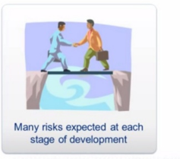
SDLC - Spiral Model
The spiral model combines the idea of iterative development with the systematic, controlled aspects of the waterfall model.

Slide 28
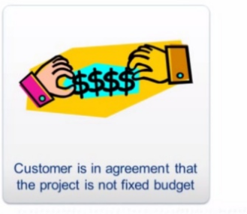

Slide 29
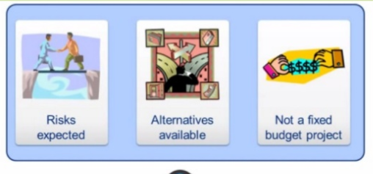

Slide 30
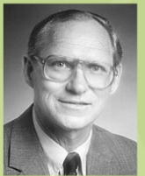
This model was first described by Barry Boehm in his 1986 paper "A Spiral Model of Software Development and Enhancement.

Slide 31
Spiral Model - Design
The spiral model has four phases.
A software project repeatedly passes through these phases in iterations called Spirals.
Identification
Design
Construct or Build
Evaluation and Risk Analysis

Slide 32
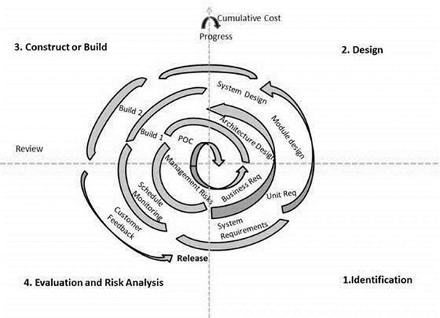

Slide 33
Identification
Gather the business requirements.
Define the problem with as much detail as possible by interviewing the client and potential users of the system, as well as, studying any existing system.

Slide 34
Design
The Design phase starts with the conceptual design in the baseline spiral and involves architectural design, logical design of modules, physical product design and the final design in the subsequent spirals

Slide 35
Construct or Build
production of the actual software product at every spiral.
In the baseline spiral, when the product is just thought of and the design is being developed a POC (Proof of Concept) is developed in this phase to get customer feedback.
Then in the subsequent spirals with higher clarity on requirements and design details a working model of the software called build is produced with a version number. These builds are sent to the customer for feedback.

Slide 36
Evaluation and Risk Analysis
Risk Analysis includes identifying, estimating and monitoring the technical feasibility and management risks, such as schedule slippage and cost overrun. After testing the build, at the end of first iteration, the customer evaluates the software and provides feedback

Slide 37
Advantages | Disadvantages
Additional functionality or changes can be done at a later stage | Risk of not meeting the schedule or budget
Cost estimation becomes easy as the prototype building is done in small fragments | It works best for large projects only also demands risk assessment expertise
Continuous or repeated development helps in risk management | For its smooth operation spiral model protocol needs to be followed strictly
Development is fast and features are added in a systematic way | Documentation is more as it has intermediate phases
There is always a space for customer feedback | It is not advisable for smaller project, it might cost them a lot

Slide 38

SDLC - Big Bang Model
The Big Bang model is an SDLC model where we do not follow any specific process
Little planning.
Usually this model is followed for small projects where the development teams are very small.

Slide 39
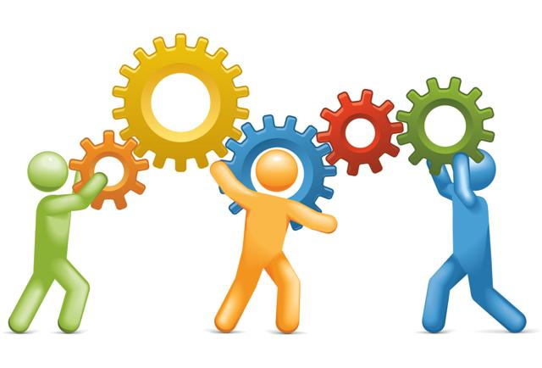
Big Bang Model ─ Design and Application
This model is ideal for small projects with one or two developers working together and is also useful for academic or practice projects. It is an ideal model for the product where requirements are not well understood and the final release date is not given.

Slide 40
Big Bang Model - Pros
The advantage of this Big Bang Model is that it is very simple and requires very little or no planning. Easy to manage and no formal procedure are required.
This is a very simple model
Little or no planning required
Easy to manage
Very few resources required
Gives flexibility to developers
It is a good learning aid for new comers or students.

Slide 41

Big Bang Model - Cons
Very High risk and uncertainty.
Not a good model for complex and object-oriented projects.
Poor model for long and ongoing projects.
Can turn out to be very expensive if requirements are misunderstood.

